Slide 1
Probabilistic Models for Supervised Learning (3): Generative Classification and Regression
CS771: Introduction to Machine Learning
Piyush Rai

Slide 2








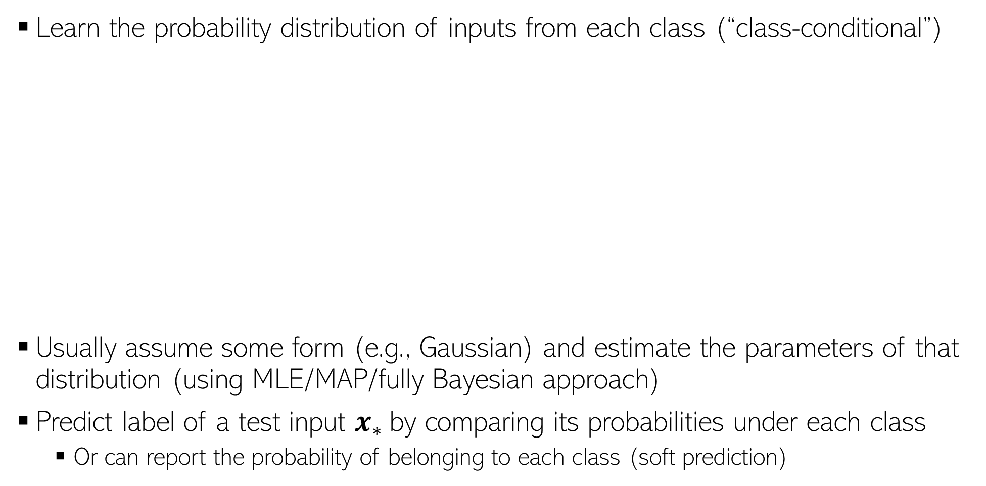


Generative Classification: A Basic Idea
Learn the probability distribution of inputs from each class (“class-conditional”)
Usually assume some form (e.g., Gaussian) and estimate the parameters of that distribution (using MLE/MAP/fully Bayesian approach)
Predict label of a test input $x_{∗}$by comparing its probabilities under each class
Or can report the probability of belonging to each class (soft prediction)
Yes. We can do it by incorporating class prior probabilities (proportion of each class in the training data) in our model
What if I a priori expect that the red class is more likely for a test input because the training data also had more red examples?
$$p(x|"red")$$
Then we can compute and compare the class posterior probabilities of each class for the test input
$$p(x_{∗}|class)$$
$$p(x_{∗}|class)$$
$$p(x|"green")$$
Can I incorporate that knowledge?
$$p(x_{∗}|class)$$
Going to talk about this next
$$x_{∗}$$
$$x_{∗}$$
$$x_{∗}$$

Slide 3


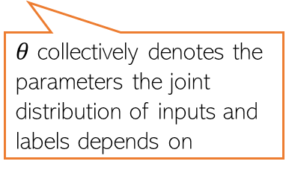
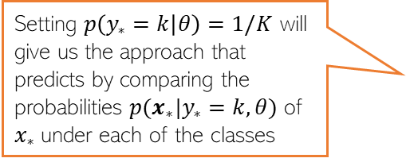
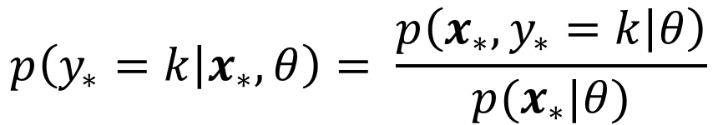

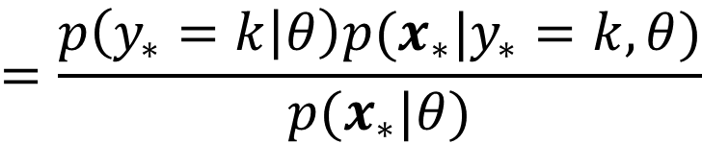

Generative Classification: More Generally..
Roughly speaking, what’s the fraction of each class in the training data
Consider a classification problem with $K ≥ 2$classes
The class prior probability of each class $k∈ \{1,2,…,K\}$ is $p(y=k)$
Can use Bayes rule to compute class posterior probability for a test input $x_{∗}$
We will first estimate the parameters of class prior and class-conditional distributions. Once estimated, we can use the above rule to predict the label for any test input
Can use MLE/MAP/fully Bayesian approach. We will only consider MLE/MAP here
Class prior distribution for class $k$
Class-conditional distribution of inputs from class $k$
$$p\left(y_{∗}=k | x_{∗},θ\right)= \frac{p\left(x_{∗},y_{∗}=k | θ\right)}{p(x_{∗}|θ)}$$
$$=\frac{p\left(y_{∗}=k | θ\right)p(x_{∗}|y_{∗}=k,θ)}{p(x_{∗}|θ)}$$
$θ$ collectively denotes the parameters the joint distribution of inputs and labels depends on
Setting $p\left(y_{∗}=k | θ\right)=1/K$ will give us the approach that predicts by comparing the probabilities $p(x_{∗}|y_{∗}=k,θ)$ of $x_{∗}$under each of the classes
This is just the marginal distribution of the joint distribution in the numerator (summed over all $K$ values of $y_{∗}$)

Slide 4
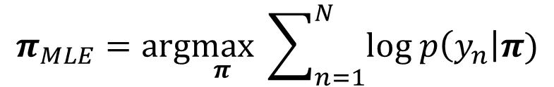


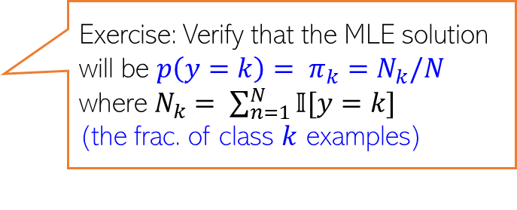
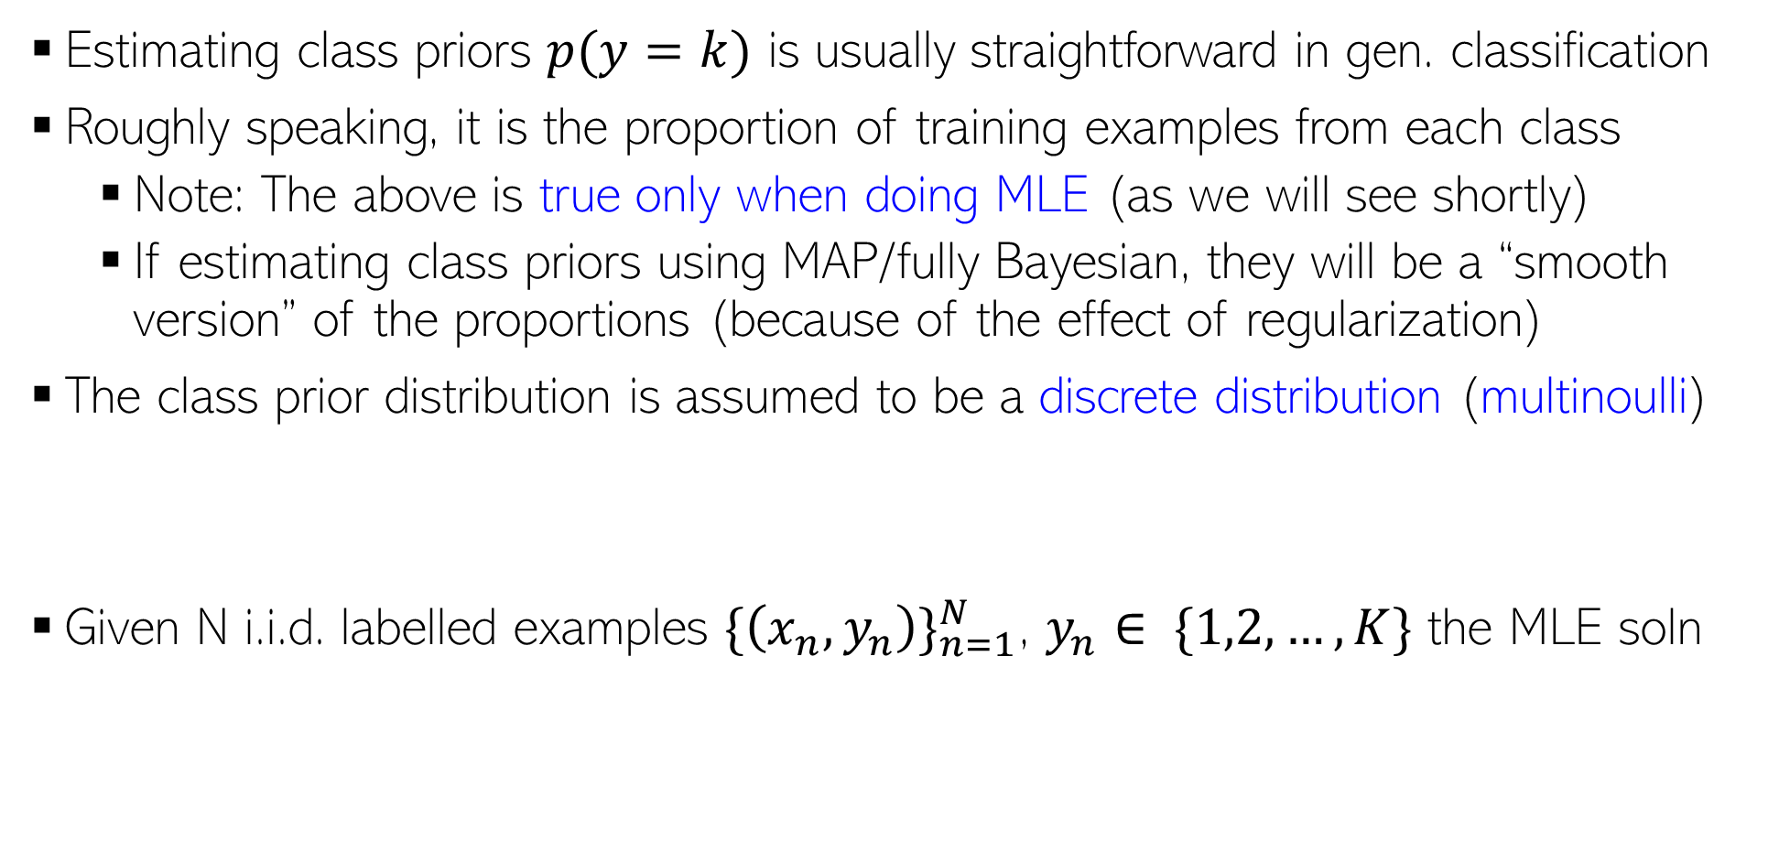
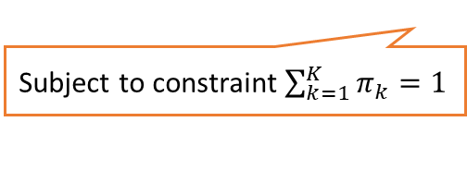

Estimating Class Priors
Note: Can also do MAP estimation using a Dirichlet prior on $π$ (this is akin to using Beta prior for doing MAP estimation for the bias of a coin). May try this as an exercise
Estimating class priors $p(y=k)$ is usually straightforward in gen. classification
Roughly speaking, it is the proportion of training examples from each class
Note: The above is true only when doing MLE (as we will see shortly)
If estimating class priors using MAP/fully Bayesian, they will be a “smooth version” of the proportions (because of the effect of regularization)
The class prior distribution is assumed to be a discrete distribution (multinoulli)
Given N i.i.d. labelled examples ${\{\left(x_{n},y_{n}\right)\}}_{n=1}^{N}$, $y_{n}∈ \{1,2,…,K\}$ the MLE soln
$$π_{k} = p(y=k)$$
These probabilities sum to 1: $\sum_{k=1}^{K}{π_{k}=1}$
Generalization of Bernoulli
$p\left(y | π\right)=multinoulli(y|π_{1},π_{2},…,π_{K})= \prod_{k=1}^{K}{π_{k}^{𝕀[y=k]}}$
$$π_{MLE}=arg\max_{π} \sum_{n=1}^{N}{log p\left(y_{n}\right|π)}$$
Exercise: Verify that the MLE solution will be ${p\left(y=k\right)= π}_{k}=N_{k}/N$
where $N_{k}= \sum_{n=1}^{N}{𝕀[y=k]}$
(the frac. of class $k$ examples)
Can use Lagrange based opt. (note that we have an equality constraint)
Subject to constraint $\sum_{k=1}^{K}{π_{k}=1}$

Slide 5
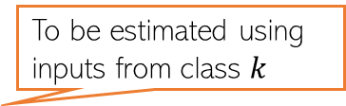
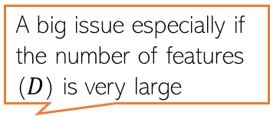
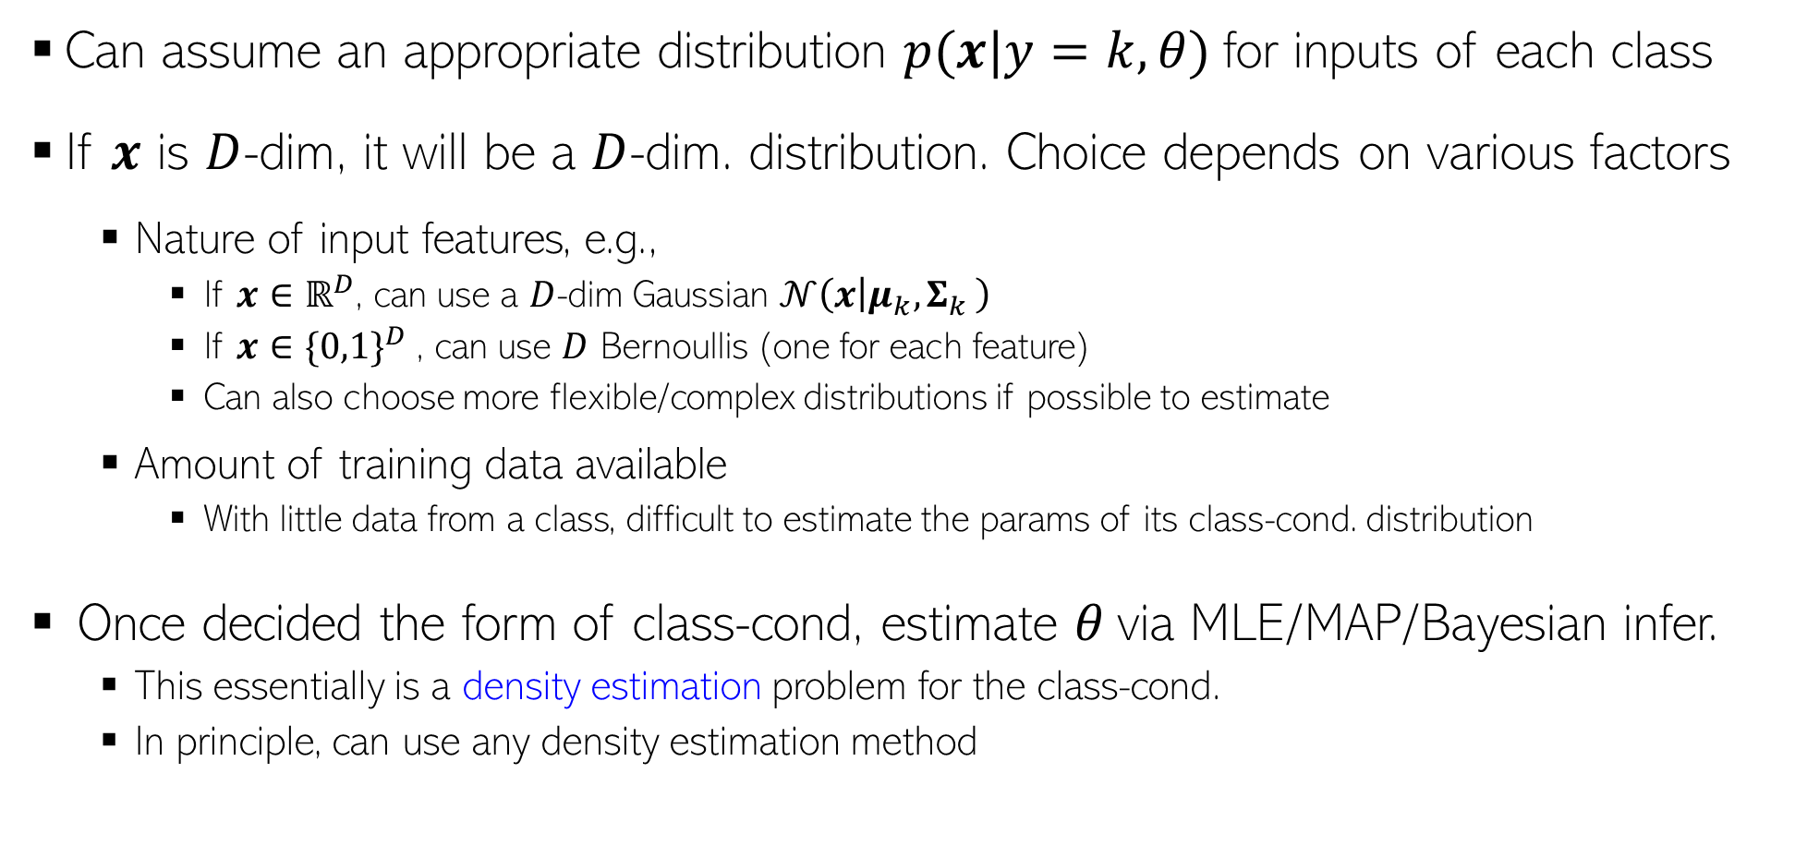
Estimating Class-Conditionals
To be estimated using inputs from class $k$
Can assume an appropriate distribution $p(x|y=k,θ)$for inputs of each class
If $x$ is $D$-dim, it will be a $D$-dim. distribution. Choice depends on various factors
Nature of input features, e.g.,
If $x∈ℝ^{D}$, can use a $D$-dim Gaussian $𝒩\left(x | μ_{k}{,Σ}_{k}\right)$
If $x∈{\{0,1\}}^{D}$, can use $D$ Bernoullis (one for each feature)
Can also choose more flexible/complex distributions if possible to estimate
Amount of training data available
With little data from a class, difficult to estimate the params of its class-cond. distribution
Once decided the form of class-cond, estimate $θ$via MLE/MAP/Bayesian infer.
This essentially is a density estimation problem for the class-cond.
In principle, can use any density estimation method
Some workarounds: Use strong regularization, or a simple form of the class-conditional (e.g., use a spherical/diagonal rather than a full covariance if the class-cond is Gaussian), or assume features are independent given class (“naïve Bayes” assumption)
A big issue especially if the number of features ($D$) is very large

Slide 6
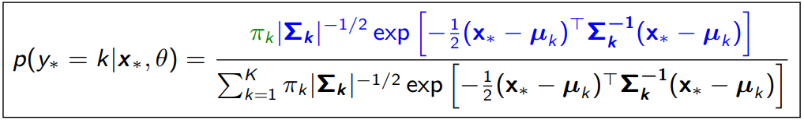
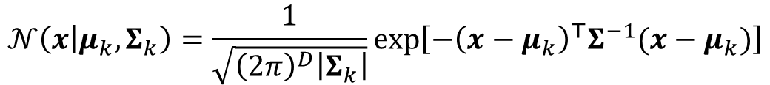
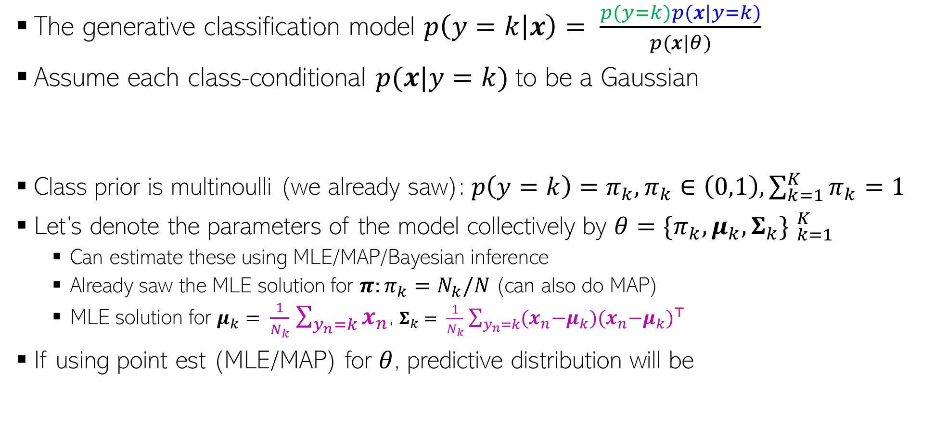
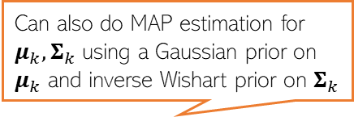
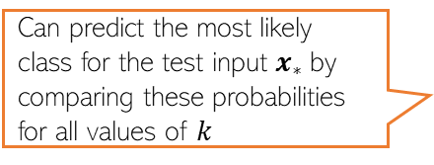
Gen. Classifn. using Gaussian Class-conditionals
A benefit of modeling each class by a distribution (recall that LwP had issues)
The generative classification model $p\left(y=k | x\right)= \frac{p(y=k)p(x|y=k)}{p(x|θ)}$
Assume each class-conditional $p(x|y=k)$to be a Gaussian
Class prior is multinoulli (we already saw): $p\left(y=k\right)=π_{k}, π_{k}∈\left(0,1\right), \sum_{k=1}^{K}{π_{k}}=1$
Let’s denote the parameters of the model collectively by $θ={\{π_{k},μ_{k},Σ_{k}\} }_{k=1}^{K}$
Can estimate these using MLE/MAP/Bayesian inference
Already saw the MLE solution for $π:π_{k}=N_{k}/N$ (can also do MAP)
MLE solution for $μ_{k}= \frac{1}{N_{k}}$ $\sum_{y_{n}=k}{x_{n}}$, $Σ_{k}= \frac{1}{N_{k}}$ $\sum_{y_{n}=k}{{{(x}_{n}−μ_{k}){(x}_{n}−μ_{k})}^{⊤}}$
If using point est (MLE/MAP) for $θ$, predictive distribution will be
Since the Gaussian’s covariance models its shape, we can learn the shape of each class ☺
$$𝒩\left(x | μ_{k},Σ_{k}\right)=\frac{1}{\sqrt{{\left(2π\right)}^{D}\left|Σ_{k}\right|}}exp\left[−{\left(x−μ_{k}\right)}^{⊤}Σ^{−1}(x−μ_{k})\right]$$
Can also do MAP estimation for $μ_{k},Σ_{k}$ using a Gaussian prior on $μ_{k}$ and inverse Wishart prior on $Σ_{k}$
Exercise: Try to derive this. I will provide a separate note containing the derivation
Can predict the most likely class for the test input $x_{∗}$by comparing these probabilities for all values of $k$
Note that the exponent has a Mahalanobis distance like term. Also, accounts for the fraction of training examples in class k

Slide 7
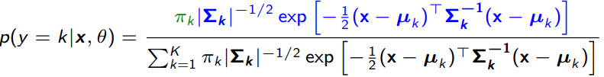
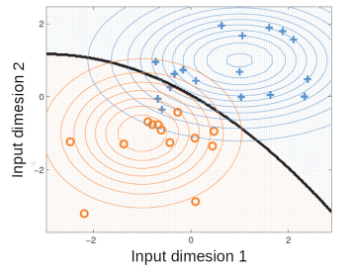

Decision Boundary with Gaussian Class-Conditional
As we saw, the prediction rule when using Gaussian class-conditional
The decision boundary between any pair of classes will be a quadratic curve
Reason: For any two classes $k$ and $k^{′}$ at the decision boundary, we will have $p\left(y=k | x,θ\right)=p(y=k^{′}|x,θ)$. Comparing their logs and ignoring terms that don’t contain $x$, can easily see that
Decision boundary contains all inputs $x$ that satisfy the above
This is a quadratic function of $x$ (this model is sometimes referred to Quadratic Discriminant Analysis)

Slide 8
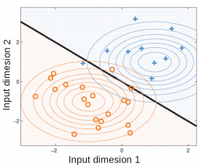
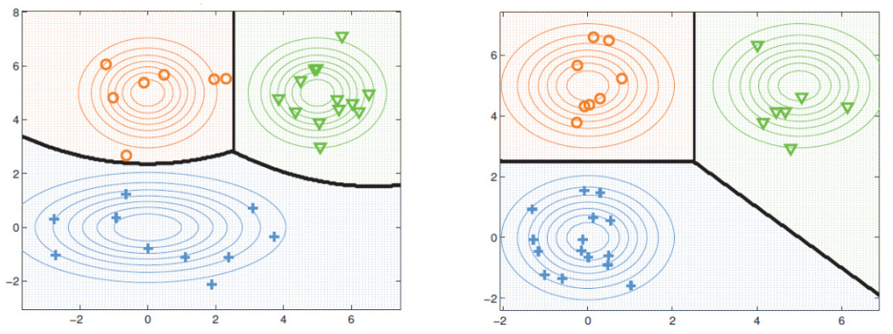

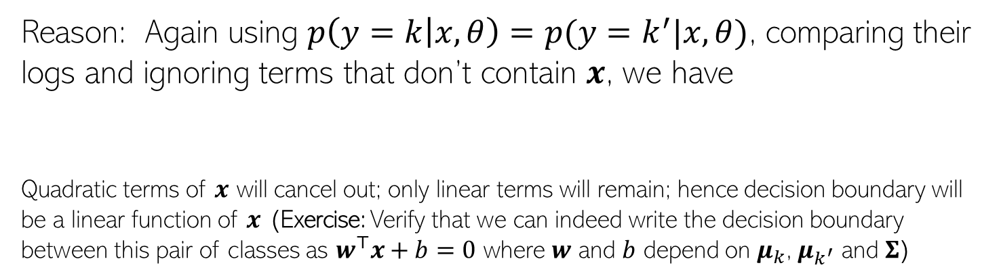
Decision Boundary with Gaussian Class-Conditional
Assume all classes are modeled using the same covariance matrix $Σ_{k}=Σ, ∀k$
In this case, the decision boundary b/w any pair of classes will be linear
Reason: Again using $p\left(y=k | x,θ\right)=p(y=k^{′}|x,θ)$, comparing their logs and ignoring terms that don’t contain $x$, we have
Quadratic terms of $x$ will cancel out; only linear terms will remain; hence decision boundary will be a linear function of $x$ (Exercise: Verify that we can indeed write the decision boundary between this pair of classes as $w^{⊤}x+b=0$ where $w$ and $b$ depend on $μ_{k}$, $μ_{k^{′}}$ and $Σ$)
If we assume the covariance matrices of the assumed Gaussian class-conditionals for any pair of classes to be equal, then the learned separation boundary b/w this pair of classes will be linear; otherwise, quadratic as shown in the figure on left

Slide 9

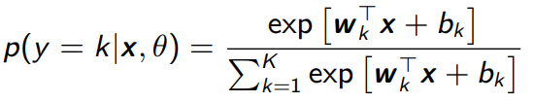



A Closer Look at the Linear Case
For the linear case (when $Σ_{k}=Σ, ∀k$), the class posterior probability
Expanding further, we can write the above as
Therefore, the above class posterior probability can be written as
The above has exactly the same form as softmax classification(thus softmax is a special case of a generative classification model with Gaussian class-conditionals)
If all Gaussians class-cond have the same covariance matrix (basically, of all classes are assumed to have the same shape)

Slide 10



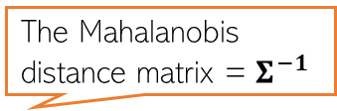
A Very Special Case: LwP Revisited
Note the prediction rule when $Σ_{k}=Σ, ∀k$
Also assume all classes to have equal no. of training examples, i.e., $π_{k}=1/K$. Then
Equivalent to assigning $x$ to the “closest” class in terms of a Mahalanobis distance
If we further assume $Σ=I_{D}$ then the above is exactly the LwP rule
The Mahalanobis distance matrix = $Σ^{−1}$

Slide 11
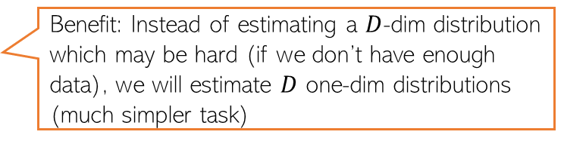
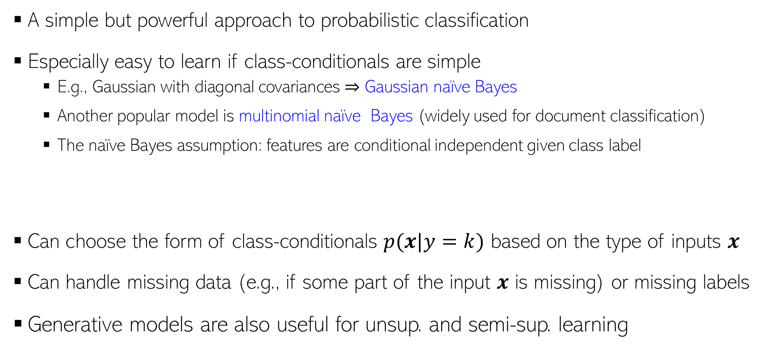
Generative Classification: Some Comments
A simple but powerful approach to probabilistic classification
Especially easy to learn if class-conditionals are simple
E.g., Gaussian with diagonal covariances ⇒ Gaussian naïve Bayes
Another popular model is multinomial naïve Bayes (widely used for document classification)
The naïve Bayes assumption: features are conditional independent given class label
Can choose the form of class-conditionals $p(x|y=k)$ based on the type of inputs $x$
Can handle missing data (e.g., if some part of the input $x$ is missing) or missing labels
Generative models are also useful for unsup. and semi-sup. learning
Benefit: Instead of estimating a $D$-dim distribution which may be hard (if we don’t have enough data), we will estimate $D$ one-dim distributions (much simpler task)
$p\left(x | y=k\right)=$ $\prod_{d=1}^{D}{p(x_{d}|y=k)}$
Will see such methods later
Will see such methods later

Slide 12

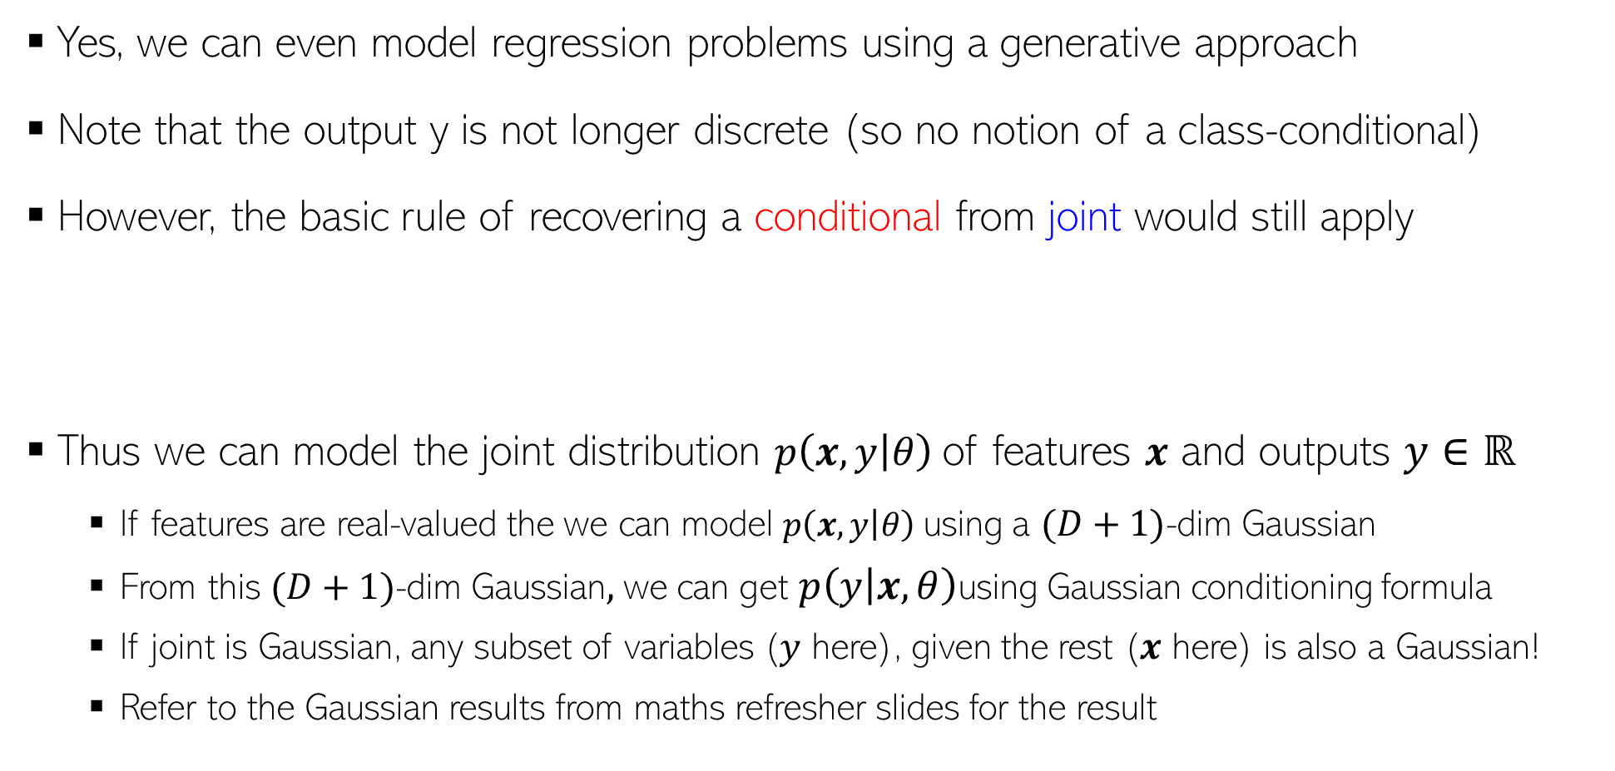
Generative Models for Regression
Yes, we can even model regression problems using a generative approach
Note that the output y is not longer discrete (so no notion of a class-conditional)
However, the basic rule of recovering a conditional from joint would still apply
Thus we can model the joint distribution $p\left(x,y | θ\right)$of features $x$ and outputs $y∈ℝ$
If features are real-valued the we can model $p\left(x,y | θ\right)$using a $(D+1)$-dim Gaussian
From this $(D+1)$-dim Gaussian$,$we can get $p\left(y | x,θ\right)$using Gaussian conditioning formula
If joint is Gaussian, any subset of variables ($y$ here), given the rest ($x$ here) is also a Gaussian!
Refer to the Gaussian results from maths refresher slides for the result
$$p\left(y | x,θ\right)= \frac{p\left(x,y | θ\right)}{p(x|θ)}$$

Slide 13
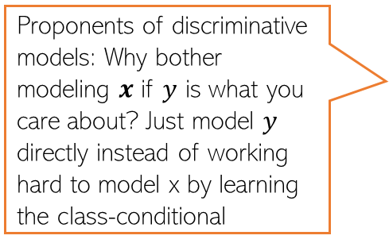
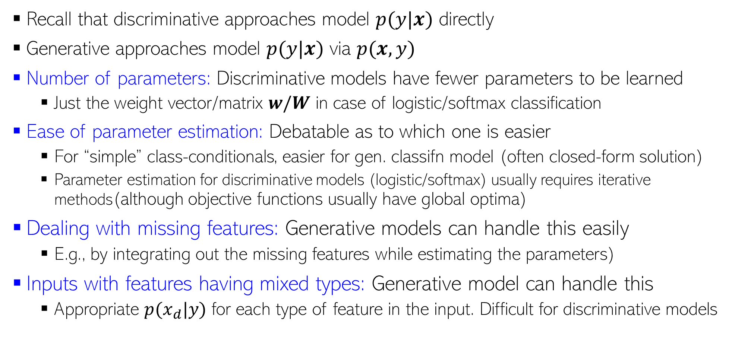
Discriminative vs Generative
Proponents of discriminative models: Why bother modeling $x$ if $y$ is what you care about? Just model $y$ directly instead of working hard to model x by learning the class-conditional
Recall that discriminative approaches model $p(y|x)$ directly
Generative approaches model $p(y|x)$ via $p(x,y)$
Number of parameters: Discriminative models have fewer parameters to be learned
Just the weight vector/matrix $w/W$ in case of logistic/softmax classification
Ease of parameter estimation: Debatable as to which one is easier
For “simple” class-conditionals, easier for gen. classifn model (often closed-form solution)
Parameter estimation for discriminative models (logistic/softmax) usually requires iterative methods(although objective functions usually have global optima)
Dealing with missing features: Generative models can handle this easily
E.g., by integrating out the missing features while estimating the parameters)
Inputs with features having mixed types: Generative model can handle this
Appropriate $p(x_{d}|y)$ for each type of feature in the input. Difficult for discriminative models

Slide 14
Discriminative vs Generative (Contd)
Leveraging unlabeled data: Generative models can handle this easily by treating the missing labels are latent variables and are ideal for Semi-supervised Learning. Discriminative models can’t do it easily
Adding data from new classes: Discriminative model will need to be re-trained on all classes all over again. Generative model will just require estimating the class-cond of newly added classes
Have lots of labeled training data? Discriminative models usually work very well
Final Verdict? Despite generative classification having some clear advantages, both methods can be quite powerful (the actual choice may be dictated by the problem)
Important to be aware of their strengths/weaknesses, and also the connections between these
Possibility of a Hybrid Design? Yes, Generative and Disc. models can be combined, e.g.,
“Principled Hybrids of Generative and Discriminative Models” (Lassere et al, 2006)
“Deep Hybrid Models: Bridging Discriminative & Generative Approaches” (Kuleshov & Ermon, 2017)

Slide 15
Coming up next
Large-margin hyperplane based classifiers (support vector machines)
Kernel methods for learning nonlinear models

